Slide 1
Empowering Decisions: Data-Driven Insights for Buy.Bx
Presented by;
Sandra Ake-Kennedy

Slide 2
Introduction
In this report, we analyse the dataset related to Buy.Bx Our goal is to extract actionable insights that will guide strategic decisions and foster business growth. The dataset includes the Orders Data, which provides insights into revenue generation and orders fulfilment.
Through comprehensive analysis, we aim to provide stakeholders with valuable insights into
Market Trends
Revenue Performance
These insights will support informed decision-making and strategic planning, enhancing Buy.Bx competitive edge and promoting sustainable growth.

Slide 3
Objectives
The objective of this presentation includes:
Create a performance report aided by a dashboard that captures key metrics to ensure Buy.Bx business remains competitive.
Assess the performance of the various variables in relation to the key KPIs.
Suggest actionable insights to the stakeholders to guide the eventual decision making.

Slide 4
Methodology
As the aim of this presentation is to provide Buy.Bx with a competitive advantage through informed decision, the methodology employed is rigorous to ensure that our findings are grounded in empirical evidence and can serve as a reliable basis for strategic decision-making.
Requirement Gathering For Case Study
Visual Development (Dashboard)
Data Ingestion
Analysis
Recommendation
Identify possible insights and KPIs that can be generated from the available datasets.
Ingest data into a visualization software and ensure 99% accuracy.
Develop visuals to generate insights identified from requirement gathering
Carryout statistical and trend analysis using empirical evidence.
Recommend actionable solutions as a decision criteria.
Notes:
How presentation will benefit audience: Adult learners are more interested in a subject if they know how or why it is important to them.
Presenter’s level of expertise in the subject: Briefly state your credentials in this area, or explain why participants should listen to you.

Slide 5
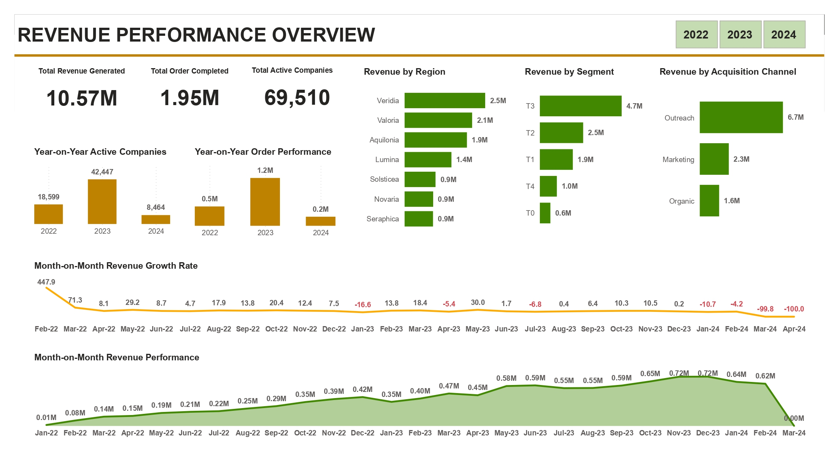


REVENUE PERFORMANCE OVERVIEW
Total Revenue Generated
Quantity Sold
Total Order Completed
Profit Margin
Total Earnings
2,292,669
37,873
9,994
12.5%
286,397
Revenue by Top 10 Countries
Elbonia
457,688
Novuron
308,425
Angwala
170,188
Zabia
138,123
Caydaia
116,512
Veridia
88,448
Noroqco
80,166
Belthria
78,258
Farelo
76,270
Glacita
70,637

Slide 6
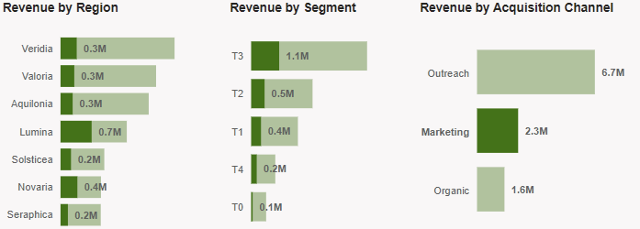
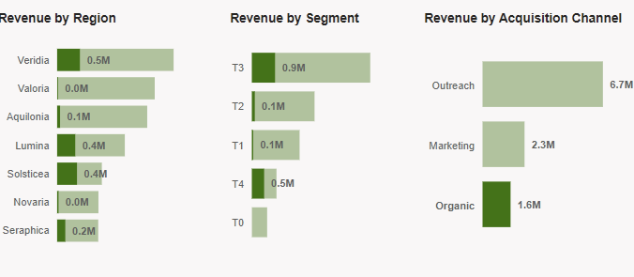
Drill-Down Revenue Findings
The Outreach acquisition channel stands out as the primary revenue driver, contributing significantly to Buy.Bx overall success. However, a deeper dive into individual channel performances reveals intriguing nuances. The Marketing channel emerges as a potent force, generating revenue exceeding 673,000 which remarkably accounts for 47% of Lumina’s total revenue as seen in figure 2. This suggests that the Buy.Bx business’ marketing channel acquisition model experienced positive alignment with customers within the Lumina region.
Despite being among Buy.Bx top three overall revenue-generating regions, Valoria and Aquilonia alongside Novaria exhibit subdued performance in the context of the organic acquisition channel. This suggest that these regions have not fully capitalized on the potential impact of organic acquisition channel. This is illustrated in figure 3.
Figure 2
Figure 3

Slide 7
Findings From Revenue Performance Overview
1. Revenue and Order Metrics:
Total Revenue: Buy.Bx business has generated an impressive 10.57 million in revenue during this period.
Order Volume: Approximately 1.95 million orders have been successfully completed.
Average Revenue per Order: Across the same date range, Buy.bx business achieved an average revenue of 5.43 per order.
2. Revenue Trajectory:
The revenue trajectory has been consistently upward. Starting from a modest 14,451 in January 2022, it has grown exponentially to achieving 615,471 by March 2024.
3. Month-on-Month Growth:
The recurring revenue exhibits positive momentum, with sustained growth in most months. Only six months between January 2022 and March 2024 deviated from this trend.
4. Top Performing Locations:
The lion’s share of Buy.Bx revenue—61%—emanates from three key locations: Veridia, Valoria, and Aquilonia. These locations have contributed significantly, with figures surpassing 1.91 million each.
5. Top Performing Segments:
The top performing segment is T3 with 4.66 million in revenue, followed by T2 with 2.47 million and T1 capping off the top 3 with a revenue of 1.88 million.
6. Acquisition Channels:
The Outreach acquisition channel stands out, accounting for over 63% of the total revenue during the review period. This dominance sets it apart from other acquisition channels with 2.33 million generated by Marketing and 1.56 million generated by Organic.
7. Year-on-Year Performance:
2023 was a standout year, achieving remarkable growth with above 140% increase in revenue compared to 2022.
Also, early data for 2024 suggests that Buy.Bx business may face challenges in surpassing the exceptional performance of 2023.

Slide 8
Recommendations
Quarterly Marketing Surge:
Since the Marketing channel exhibits peak performance during Q1 and Q4, Buy.Bx business can allocate resources strategically to capitalize on seasonal trends by considering product launches, promotions, and brand visibility enhancements during these critical periods.
2. Regional Excellence:
Since Veridia, Valoria, and Aquilonia drive the lion’s share of Buy.Bx revenue, investing in localized marketing campaigns, customer retention programs, and community engagement would solidify Buy.bx’s position in these key areas.
. 3 Personalize Marketing Strategies:
Analyze customer preference within the Lumina region to create tailored campaigns, ensuring customer retention and engagement.

Slide 9
Thank You.

